Slide 1
Devops Performance Testing
Jan De Coster
Solution Architect ,Micro Focus

Slide 2
Agenda
Performance Testing Market Landscape
Performance Testing for DevOps
Implementation examples

Slide 3
Performance Testing Market Landscape
Notes:
Let’s now understand the Performance Testing Market landscape.

Slide 4


















An evolutionary journey resulting in great complexity
Internet
of
Things
(IoT)
Public Cloud
Private
Cloud
z / OS
PL / I
COBOL
CICS
IMS
Notes:
Over many years innovation has been at the forefront for most organizations – although this has created now a very complex environment. This has changed massively in the relatively short history of the IT industry. Co-located, highly cohesive teams with deep subject matter expertise have become highly distributed, multi-disciplined teams that work at speed. Over time, the realization of new computing platforms, new networking infrastructures and new application access models has produced a very complex picture, and enterprise organizations need to balance many combinations of these simultaneously. This has extended further again with DevOps, IoT, Cloud and Mobile technologies.

Slide 5
Digital Transformation – massive budget shift
Back office
Digital front office
Systems of record
Systems of engagement
$
80% | 45%
2011 | 2016
20% | 55%
2011 | 2016
Source: Forrester
Notes:
Digital technologies – and the ways we use them in our personal lives and work – have dramatically changed the face of business. The pace at which it is happening now is accelerating and faster than the pace of transformation in organizations. Digital transformation is the accelerating transformation of business activities, processes, and models to fully leverage the changes and opportunities of digital technologies. This is a direct response to the "age of the customer": Empowered buyers demand a new level of customer obsession!
In order to close the expectation gap between customer expectations and business's responsiveness, organizations are massively shifting their budgets from the back office to the digital front office – from the 'systems of record' to the 'systems of engagement'.
Systems of record host processes! These are traditional enterprise applications like enterprise resource planning, finance/accounting and human capital management.
Systems of engagement touch people! Systems of engagement empower customers, partners, and employees with context-rich apps and smart products to help them decide and act immediately in their moments of need.
This represents a huge opportunity for us – in order to meet customer expectations the digital front end needs to work flawlessly and fast across all channels and platforms, independent of browsers, devices, connection speeds and geographies. Lots of things that need to be tested!

Slide 6
Performance matters!
Yahoo
1s additional server delay
=
2.8% revenue decrease
Amazon
100MS delay
=
$6.79M
Sales decrease
Speed is King
Every Millisecond Counts!!
Google
100-400MS Slowdown
=
$45-$135M
Loss in AdWords revenue
Microsoft
100ms speed increase
=
0.6% revenue increase
Source: How Performance Affects User Experience and Your Bottom Line, and What to Do About It. (2014). Gartner
Notes:
Within the customer journey, performance is today as important as any other functional aspect of your applications and websites.
Leading Internet companies have long been obsessed with optimizing the performance of their websites. And several have published reports where they share their findings:
Amazon for instance has performed experiments showing that for every 100ms delay, its sales decreased by 1% — which translates to $6.8 million of decreased sales per year.
Also Microsoft has performed experiments showing that for every 100ms speed increase it was able to improve its revenue by 0.6% as a direct result. Therefore, if an engineer at Bing manages to improve performance by 10ms that more than pays for the annual cost of that engineer.

Slide 7



Challenges on Performance Testing
Time to Market
Proliferation of Devices
User Experience
Notes:
Time To Market:
Technology and more specifically software are today’s organizations bless and curse. If from one side software can be leveraged as a faster way to deliver the next wave of competitive differentiator, it also lower the barriers of entry for existent and new competitors to provide faster, cheaper and better alternatives to your products and services offerings.
Proliferation of Devices:
Customer have never had so many choices of browsers, platforms and devices in their life, and with choices comes preferences. Whatever is the customer preferred method of accessing an application, on their computer, phone or tablet, they expect applications to behave and perform exactly in the same way.
User Experience:
Users and customers interact with software and applications more frequently than ever before. Their overall experience is determined by a number of factors including the way services are delivered, the performance of the desired outcome and the ease of use.
Every user brings with them a set of pre-existing expectations and their tolerance for a poor experience has diminished significantly over the past few years.

Slide 8

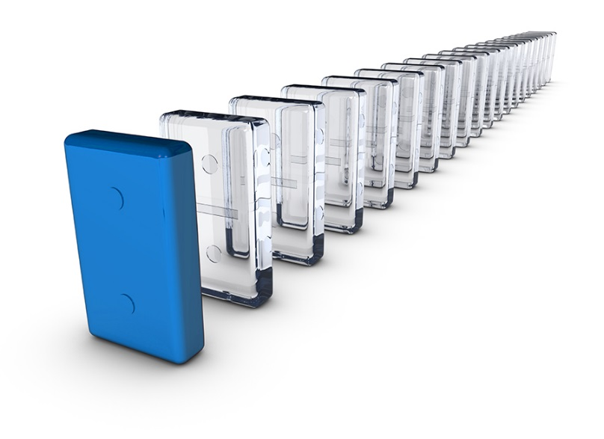
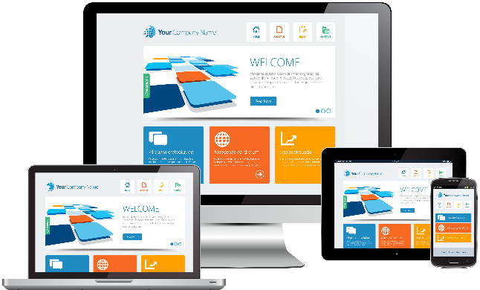
Development Teams need to
Apps working
anywhere
Customer
Expectations
Continuous Delivery
Notes:
Development Teams need to:
Ensure mobile and web applications will work as expected on any device or platform that our customers may choose to use.
Make sure applications will deliver on the customers’ expectations, anytime, anywhere, independently of the number of users in the system.
Enable continuous delivery in DevOps to not disrupt application performance expectations and business continuity.

Slide 9
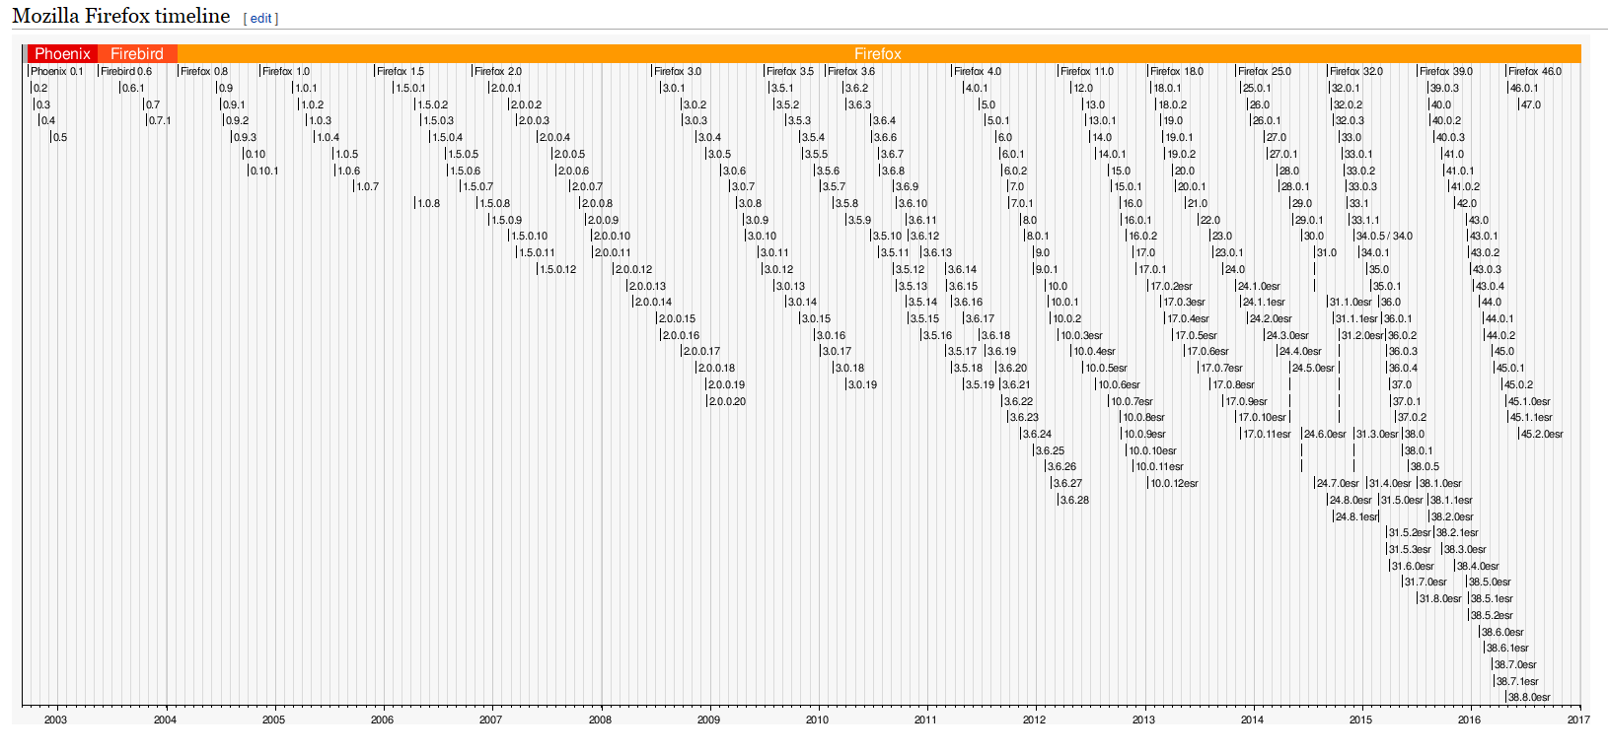
Devops: enabler for Contineous Delivery
Notes:
Development Teams need to:
Ensure mobile and web applications will work as expected on any device or platform that our customers may choose to use.
Make sure applications will deliver on the customers’ expectations, anytime, anywhere, independently of the number of users in the system.
Enable continuous delivery in DevOps to not disrupt application performance expectations and business continuity.

Slide 10
Performance Testing for DevOps

Slide 11
Performance Testing
Quickly build cross platform/device performance tests
Easily identify root cause of performance problems
Assess and report application performance issues
Apps working
anywhere
Manage all performance test assets and trends reporting
Notes:
Build performance tests that can simulate transactions on different browsers across platforms and devices.
Identify the root cause of application performance problems through powerful, end-to-end diagnostics capabilities
Accurately assess and report application performance issues across devices and platforms before deployment
Central repository coordinates and manages all performance testing and outlines inefficiencies.

Slide 12

Performance Testing
Easily simulate different user experiences
Collect and compare performance across the globe
Leverage the cloud for coverage and accuracy
Customer
Expectations
Notes:
Easily simulate users performance experience across multiple device/network bandwidth/geo location combinations.
Enable customers to easily collect and compare transaction’s performance across different geographical locations.
Leverage the cloud to reduce the cost and increase the accuracy of your performance testing

Slide 13
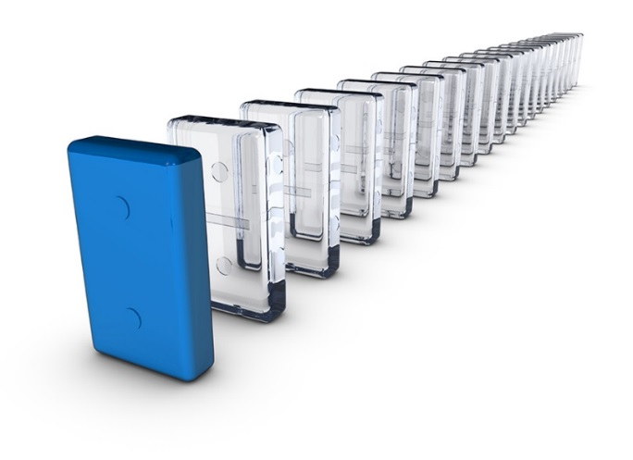
Performance Testing
Identify performance issues within continuous delivery
Ensure infrastructure will scale accordingly
Easily test cloud services across platforms and locations
Continuous Delivery
Simulate network speeds from different locations
Notes:
Easily identify performance issues across builds within your continuous delivery pipeline.
Simulates actual service usage to check if application infrastructure will scale accordingly.
Accurately tests cloud services across a variety of browser to ensure the cloud infrastructure will scale accordingly.
Simulates network speeds from various locations around the world to understand what the end user is experiencing.

Slide 14
Performance Testing Technologies
Silk Central
Silk Performer
Notes:
Micro Focus Silk Central: Unified platform to design, plan, execute and track all your functional and performance testing practices across devices and platforms
Micro Focus Silk Performer: Build performance and load testing automation that can represent your users across the globe on their devices, platforms and network of choice.

Slide 15
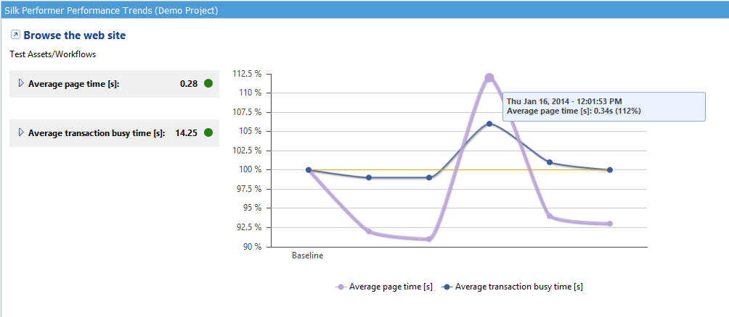
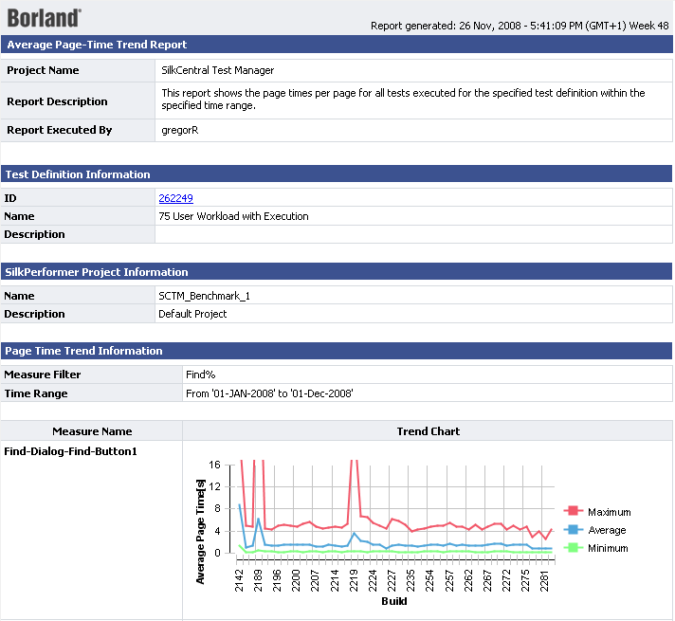
Performance Test Trendline

Slide 16
Silk Performer Agent-less Server Resource Monitoring
Application Server
ATG Dynamo
BEA WebLogic
BEA Tuxedo
IBM WebSphere
iPlanet Application Server
Macromedia ColdFusion
Macromedia Flex
MS COM+, ASP
MS .NET CLR, ASP.NET
NetDynamics
Oracle 9iAS HTTP Server
SilverStream
Database Server
MS SQL Server
Oracle
IBM DB2
Server OS Monitors
Windows PerfMon
Linux
Unix/Solaris/HP-UX/AIX
Web Server
Apache
Microsoft IIS
iPlanet
Netscape
Strong Hold
Application Deployment
Citrix MetaFrame
VMWare ESX
Streaming Media
MS Windows Media Server
Real Networks Server
ERP/CRM
SAPGUI status transactions
PeopleSoft Application Server and Process Scheduler
Open interfaces
Windows PerfMon
SNMP
SSH
Rexec
BDL scripts
Directory Server
Nerscape
iPlanet
Firewall/Load Balancer
F5 Labs 3DNS

Slide 17
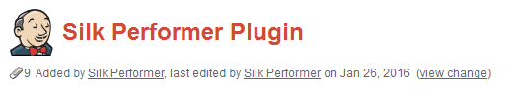
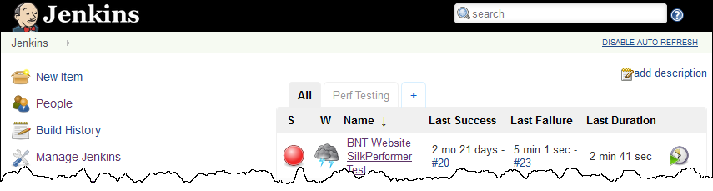
Leveraging continuous integration

Slide 18
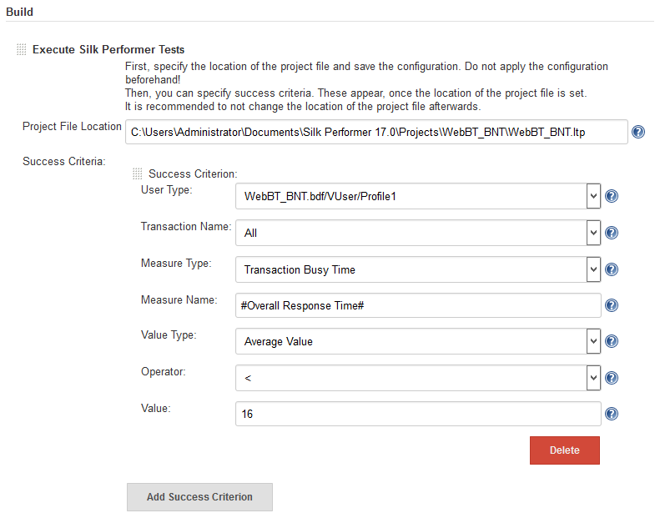
Leveraging continuous integration

Slide 19
Customer stories

Slide 20
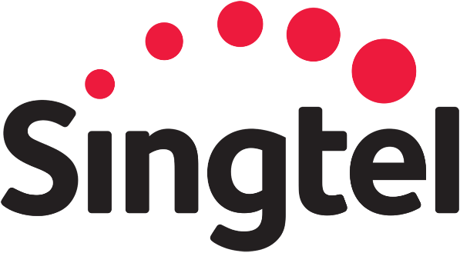

Silk Performer Customers
Black Friday testing – zero outages or downtime during 2015 holiday season thanks to Silk Performer
Largest Silk Performer load-test simulating 250k concurrent HD video streams
Notes:
https://intra.microfocus.net/company/borland-performs-the-largest-silk-performer-load-testing-with-ncs/
Earlier this month, NCS, a subsidiary of Singtel and a Borland customer based in Singapore performed the largest Silk Performer load-test that was ever run by a customer.
The infocommunications technology (ICT) service provider with more than 8,000 staff serving governments and large global commercial enterprises was providing back-end system support to their customer, AIS Thailand and required to run a test involving 250k virtual users concurrently accessing a Video on Demand system.
Gregor Rechberger, Product Manager from Borland comments, “This is a fantastic proof point of our technology and the ease of use of Silk Performer CloudBurst. The team was quick to set up and run the infrastructure required for this massive test within 10 minutes.”
The test started with 10,000 virtual users on the first day and increased to more than 250,000 rapidly on the second day of testing. In order to scale up to 250,000 concurrent virtual users, NCS used Silk Performer CloudBurst running 475 CloudBurst instances from the Singapore Amazon AWS data center.
Silk Performer provides load testing and stress testing across web, mobile, and enterprise applications. Although this is the largest Silk Performer load- test for a customer, the Borland team has run performance application testing with more than 1 million virtual users internally on multiple occasions.
The customer had spent $29K for Borland Credits (the flexible, pay-as-you-go testing virtual currency) to run the load tests for several hours. With Borland Credits, you are only charged for what you use. This eliminates up-front and unexpected capital expenses and the ongoing cost of maintaining complex infrastructures.

Slide 21
Performance Testing @DUO by A journey from Agile to BusDevOps
Why
Respond faster to changes
Reduce cost
Leverage capabilities in broader environment
How/When
Started in 2014 – provisioning of Test environments
CD – pipeline
2017 – 60 “BusDevOps” teams – 150 applications

Slide 22
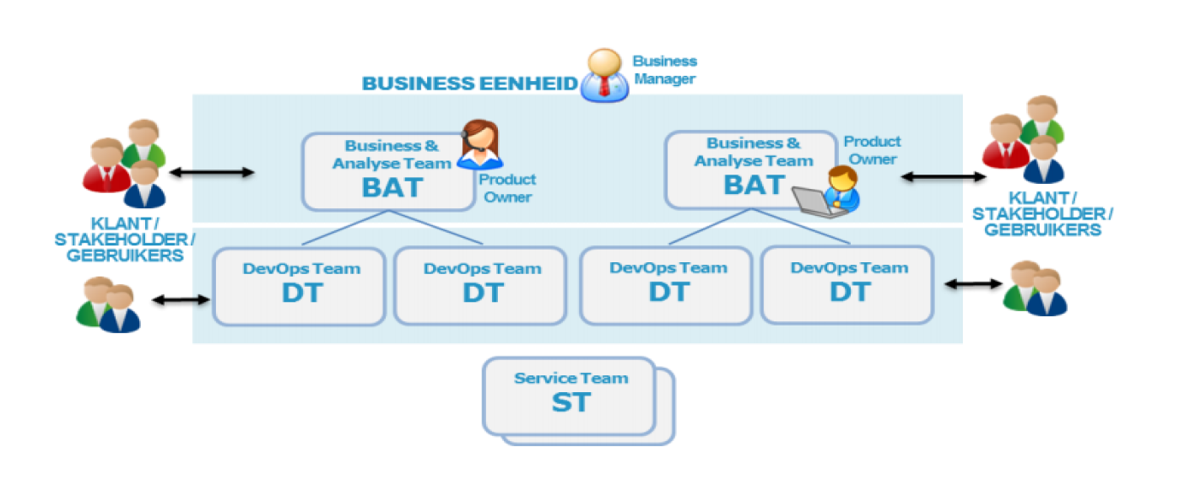
BusDevOps DUO

Slide 23
Challenges for Perf Testers in BusDevOps
Environments
Representative / Available
Shared with 60 teams
Priority of perf testing within the teams
Tooling / Script maintenance
CD Pipeline
Perf Testing – non functional requirement

Slide 24
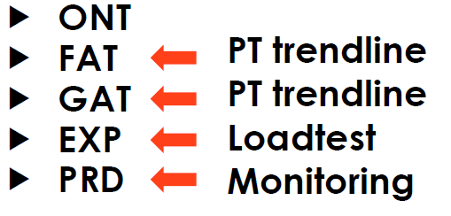
Environments
Auto provisionning of Test Environments
5 environments @ DUO for DevOps

Slide 25
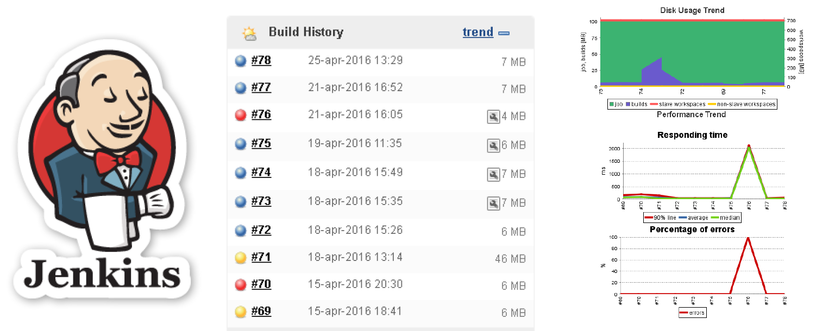
Performance Test Trendline

Slide 26

Questions
Contact - Email: Jan.De.Coster@MicroFocus.com

Slide 27
www.microfocus.com

